Slide 1
Endoscopic management of colorectal polyps
Gastroenterology Report, 11, 2023

Slide 2
Introduction
Colorectal cancer (CRC) is the third most diagnosed malignancy and second deadliest cancer in the world , causing almost 900,000 deaths annually .
The carcinogenesis process of CRC includes four pathways:
adenoma–carcinoma pathway, serrated neoplastic pathway, inflammatory pathway, and de novo pathway .
The first two pathways account for the vast majority and arise from colorectal polyps. The conventional adenoma–carcinoma pathway leads to 70% of sporadic CRC and the serrated neoplastic pathway accounts for 15%–30% of CRC .

Slide 3
Colorectal polyps are the precursors of CRC and precede long before carcinogenesis, which presents opportunities to prevent cancer by removing precursor lesions.
Nowadays, screening and resection of colorectal polyps by endoscopy is the cornerstone in reducing the incidence and mortality of CRC.

Slide 4
Assessment of colorectal polyps
Colorectal polyps are defined as discrete abnormal tissue masses protruding into the lumen of the colon or rectum Colorectal polyps have a variety of features.
Their macroscopic characterization provides information to predict the histology, biological behavior, and prognosis of the lesions.
the endoscopic description of colorectal polyps should include location, size, morphology, suspected histopathology, and estimation of depth of invasion.

Slide 5
The location can be described as proximal colon, distal colon, rectosigmoid, and difficult sites (such as the ileocecal valve, appendiceal orifice, and anorectal junction)
The size can be stratified as diminutive (5 mm),
small (6–9 mm), intermediate (10–19 mm), and large (20 mm)

Slide 6
Morphologically, colorectal polyps can follow the Paris classification of superficial neoplastic lesions :
protruding type( I) contain pedunculated (Ip) and sessile (Is) lesions;
nonprotruding and non-excavated types (II) include slightly elevated (IIa), completely flat (IIb), and slightly depressed (IIc) lesions;
ulcer is seen in excavated type (III).
Lesions assigned to Is/IIa/IIb/IIc with a size of >10 mm and extending laterally (in contrast to vertically) along the colonic wall are also known as laterally spreading lesions (LSLs) .

Slide 7
colorectal polyps are closely observed using high-resolution narrow band imaging (NBI) endoscopy
(i) lesion color, (ii) microvascular architecture, and (iii) surface pattern (also called pit pattern)
Based on the three characteristics, NBI international colorectal endoscopic classification can be made and help to discriminate hyperplastic polyps (Type 1), adenomas (Type 2), and deep submucosa-invasive cancer (Type 3)

Slide 8
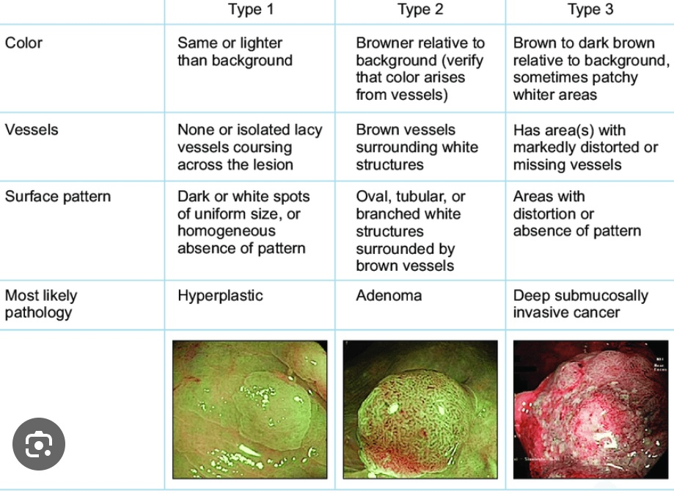

Slide 9
colorectal polyps can be classified as adenomatous polyps and serrated polyps.
Adenomatous polyps contain three histologically types:
tubular adenoma, tubulovillous adenoma, and villous adenoma .
Serrated polyps are a heterogeneous group of lesions that could be further classified into three categories:
hyperplastic polyps, sessile serrated lesions, and the traditional serrated adenomas (TSAs) .

Slide 10
Recommended resection techniques for colorectal polyps
Complete resection of colorectal polyps and prevention of CRC are the aims of endoscopic polypectomy.
Therefore, the endoscopist should choose the most complete, safest, and most effective and evidence-based resection technique.
An algorithm of polypectomy recommendations is as follows

Slide 11
For pedunculated colorectal polyps with a head of <20 mm and a stalk of <5 mm in diameter, hot snare polypectomy(HSP) is recommended.
For pedunculated colorectal polyps with a head of >20mm or a stalk of > 5 mm in diameter, the risk of post polypectomy bleeding increases because of the large vessel within the stalk. Thus, prophylactic ligation of stalk by using endoloops or clips is recommended prior to HSP

Slide 12
For non-pedunculated diminutive (<5 mm) and small(6–9 mm) lesions, it is recommended to use cold snare polypectomy (CSP) to achieve en bloc resection.
If CSP is technically difficult (lesion of <3 mm, at difficult sites), jumbo or large-capacity cold biopsy forceps polypectomy may be considered

Slide 13
For non-pedunculated lesions of >10 mm, advanced endoscopic imaging is recommended to identify the presence of submucosal invasion such as irregular or absent surface vascular patterns.
For non-pedunculated non-invasive lesions with intermediate size (10–19 mm), CSP or HSP with or without submucosal injection is recommended.
For non-pedunculated non-invasive lesions with large size(>20 mm), endoscopic mucosal resection (EMR) is recommended.
All grossly visible tissue should be resected in one session, and the post-EMR margin without visible remains should receive adjuvant thermal ablation.

Slide 14
For non-pedunculated lesions suspected of superficial submucosal invasion, EMR or endoscopic submucosal dissection (ESD) is recommended if complete resection is feasible and safe.
For non-pedunculated lesions suspected of deep submucosal invasion, surgery is recommended

Slide 15
Biopsy forceps polypectomy
Biopsy forceps can be classified as hot biopsy forceps or cold biopsy forceps, depending on whether to use electrocautery or not.
Cold forceps polypectomy (CFP) carries advantages such as the widespread and immediate device availability and simplicity of use.
However, the incomplete resection rates of CFP rise along with the lesion size, the number of bites, and the obscure bleeding field after the initial bite .

Slide 16
Hot forceps polypectomy (HFP)
Hot forceps polypectomy (HFP) can be applied to control bleeding .
However, it is recommended against the use of HFP for polypectomy because of the high rates of incomplete resection, inadequate tissue sampling for histopathological examination, and high risks of adverse events in comparison with snare excision.

Slide 17
According to the jaw volume, biopsy forceps can also be classified as large-capacity forceps and jumbo forceps . The latter have a larger cup.
Jumbo forceps are superior to the standard forceps in achieving complete visual endoscopic resection of sessile polyps measuring 6 mm and reducing the procedure time .
In practice, BFP is the most used polypectomy technique for polyps of 3 mm in that it is simple to use and there is no significant difference with CSP in complete resection rates or adverse events .
When a diminutive polyp is in a position that is difficult to snare, BFP, especially using jumbo forceps, is also alternative and applicable technique.

Slide 18
CSP
For polyps of <5 mm, CSP has a higher rate of complete resection than HFP and CFP .
For colorectal polyps sized < 10 mm, although CSP and HSP are the same in efficacy, CSP is safer than HSP.
A meta-analysis integrating 32 randomized–controlled trials (RCTs) showed that the pooled incomplete resection rate of CSP and HSP is no different.

Slide 19
The international guidelines recommend CSP as the first-line treatment for small colorectal polyps (measuring <10 mm) .
When performing CSP, it is also recommended to use a thin wire snare specifically designed for CSP and to observe the surrounding mucosa of the resection site using chromoendoscopy or image-enhanced endoscopy to ensure that there is no residual lesion .

Slide 20
HSP
HSP is defined as the snare resection for polyps involving electrocautery.
The ability to cut and coagulate simultaneously enables HSP to deal with small vessels supplying the polyps .
Although HSP could be used to remove pedunculated lesions, polyps with larger sizes require additional ligation of large vessels within the stalk .
Electrocautery results in thermal damage to the deep layers of the colon wall, which may induce tissue necrosis that proceeds laterally .
HSP was not recommended for small non-pedunculated lesions, due to the
higher risks of abdominal pain and delayed hemorrhage compared with CSP .
The side effect of electrocautery may be alleviated by submucosal injection

Slide 21
Argon plasma coagulation
APC is easier, quicker, and safer compared with other thermal/laser therapy.
Its disadvantages lie in the serious complications of perforation, gas explosion, and submucosal injection of argon gas through inadvertent contact .
Since its introduction to endoscopy, APC has been reported to manage hemostasis, angiodysplasia, radiation proctitis, and tumor debulking
APC is also a promising adjuvant treatment for large nonpedunculated lesions.
Applying APC after piecemeal snare polypectomy or EMR may help eradicate microscopic polyp remnants on the margins or at the base.

Slide 22
when polyps recur at the site of prior polypectomy, the massive submucosal scarring makes additional resection challenging.
The application of APC, preceded by submucosal injection to protect
the muscle layer, would assist in the complete eradication of recurrent fibrotic colon polyps .
The thermal effect on tissue is influenced by the duration of application, power output, and distance between the probe and the target .
Although the thermal effect usually occurs to a limited depth, APC applied to the same area for a prolonged period can cause transmural injury and perforation

Slide 23
EMR
EMR involves injections of a solution (normal saline solution or viscous solution, e.g. sodium hyaluronate, succinylated gelatin, hydroxyethyl starch, and glycerol) into the submucosal space of a superficial lesion through an injection needle .
we prefer using a mixture of methylene blue and saline. The lesion is then resected using a snare by applying high frequency current .

Slide 24
Although growing evidence shows the benefit of fewer adverse effects in cold snare EMR (EMR without applying high-frequency current) , conventional hot snare EMR (EMR using high-frequency current) is still essentially applied .
Lesions of <20 mm usually can be removed in a single piece.
lesions of >20 mm are more likely require piecemeal resection, namely piecemeal EMR.
In piecemeal EMR, a lesion is first cut into a large piece to accurately carry out histological diagnosis and the residual part is then deliberately cut into pieces .

Slide 25
Precutting EMR describes a technique where in snaring is carried out after incising the circumference of the lesion by using the tip of a snare or a knife for ESD.
Large prospective studies have demonstrated EMR as a safe, efficient, and cost-effective procedure .

Slide 26
EMR is a fundamental technique for endoscopic resection.
Although EMR can be applied to large lesions, incomplete resection and poor outcome cannot be avoided . Features associated with incomplete resection or recurrence include lesion size of >40 mm, ileocecal valve location, prior failed attempts at resection, and size, morphology, site, and access (SMSA) .
Careful lesion assessment prior to EMR is recommended .
For EMR, all efforts should be made to ensure the absence of neoplastic tissue at the post EMR mucosal defect and margin.

Slide 27
ESD
ESD begins with marking the tissue margin of 3–5 mm outside the lesion.
Subsequently, an injection procedure is performed that is similar to that in EMR. The fluid-expanded submucosal space separates the layers and offers precise control over resection depth and lateral extent.
The circumference of the lesion is then incised using an endoscopic knife with an electrical cutting current and then the submucosa is dissected

Slide 28
Simplified/hybrid ESD, which is characterized by partial submucosal dissection followed by snare assisted resection, provides a bridge between conventional EMR and full ESD .
Since en bloc resection by using ESD has shown a lower rate of recurrence compared with piecemeal resection (1%–2% compared with 10%–20% by using ESD; odds ratio, 8.2), ESD offers high rates of curative resection.
What is more, the intact specimens produced by ESD allow more accurate pathological and oncological evaluation .

Slide 29
